Slide 1
MEAN full stack Web Developer
Be the Next
With Itronics

Slide 2
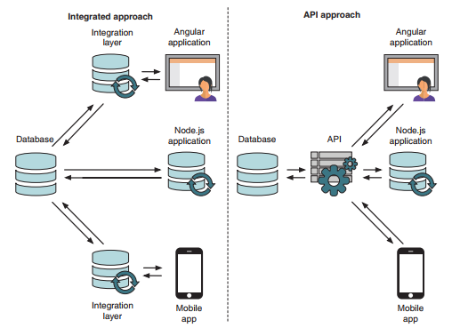
Data Integration Differences for Various Approaches used by Node.js Application

Slide 3
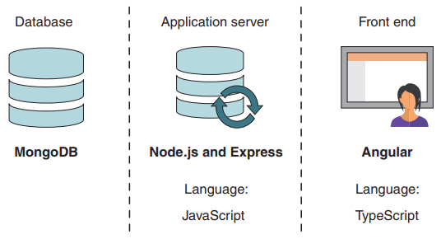

MEAN principal Technology
The MEAN stack is a pure JavaScript stack comprised of four main technologies,
with a cast of supporting technologies: MongoDB—the database, Express—the web framework, Angular—the front-end framework, Node.js—the web server

Slide 4
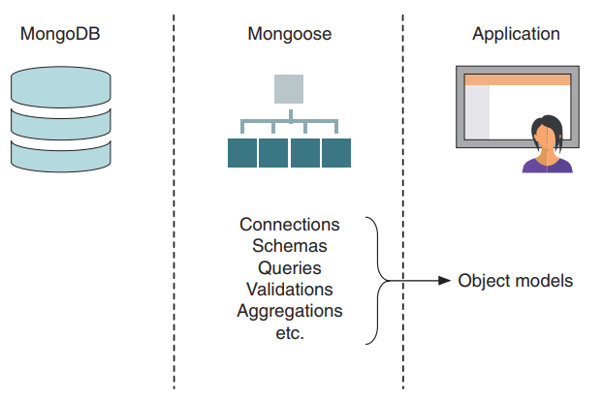
Mongoose fits between the database and the application,
providing an easy-to-use interface (object models) and access to other
functionality, such as validation.

